Slide 1
FunPod
Janette Cheng, Harshitha Ramesh, Henry Tran
Notes:
Hi, my name is Henry and I’m presenting on the changes and revisions we made to FunPod, our app meant to make diabetes management more fun and simple.

Slide 2
Overview
3 Representative Tasks
Revised UI & Rationale
Scenarios & Live Demo
Tools
Summary & Conclusion
Notes:
Changes in what are we doing? - Representative Tasks
What has changed with the interface? - Revised UI - Why did we change it?
How does it work now? - Scenarios & Live Demo
What did we use? - Tools - What worked? What didnt?

Slide 3
Representative Tasks
Checking Blood sugar
Counting Carbs
Administering Insulin/Bolusing
Tasks themselves have not changed
Notes:
The representative tasks themselves have not changed, because these are all crucial tasks that every diabetic has to execute.

Slide 4
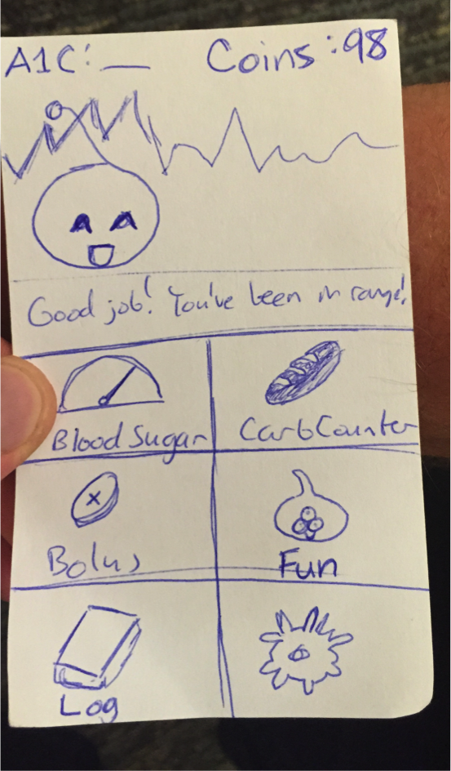
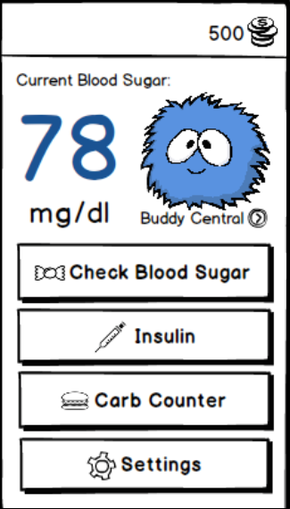
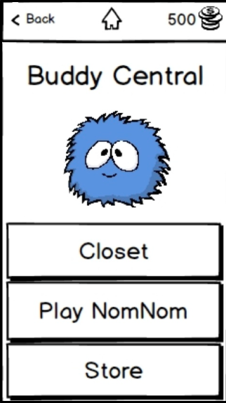
Changes
Complete Homepage overhaul
Changed “Fun” Option to Buddy Central to be more clear
Notes:
Our first revision was a complete overhaul of the homepage.
On the left, you can see our original homepage in our lo-fi prototype. During testing and feedback, we had comments about how it wasn’t clear what the “fun” button did.
What it was meant to do was bring you to a screen where you could select from all of the things you could do with your “buddy”, the avatar you have that you can play games with, change clothes, or buy items using the coins you earn for managing your blood sugar well and completing the representative tasks.
So we changed the name to “buddy central” instead, which you access by tapping on your buddy. Also, we wanted to emphasize certain elements more, so we made the blood sugar indication very big, and removing the graph we had that cluttered the screen in the lo-fi prototype.

Slide 5
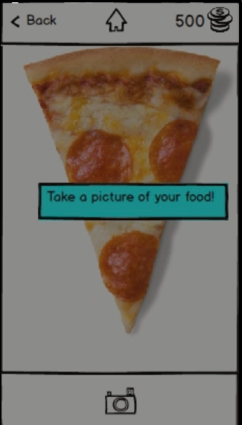
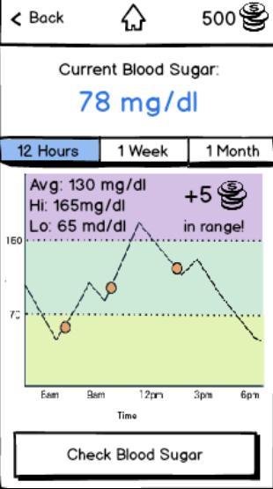
Changes
Navbar to return home, back, buddy central on all screens
Instruction to take a picture during Carb Counting
Tabs to change scope instead of pinching
Make sure user knows what to do
Notes:
Another change we had was adding a navbar to every screen, so that users could go to the previous page, home, or to buddy central from all screens. This app is meant to incentivize managing diabetes well, so the coins theyve earned is always visible in the top-right corner.
We also have an instruction to take a picture during the carb counting task, since the user doesn’t always know to take a picture if they’ve never had a system like this before.
Maintain the method of “taking a picture to count carbs” because there already exists an app that does that exact task.

Slide 6
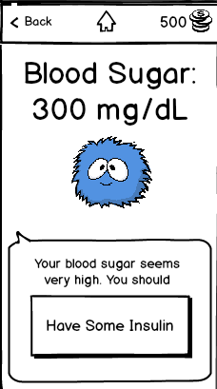
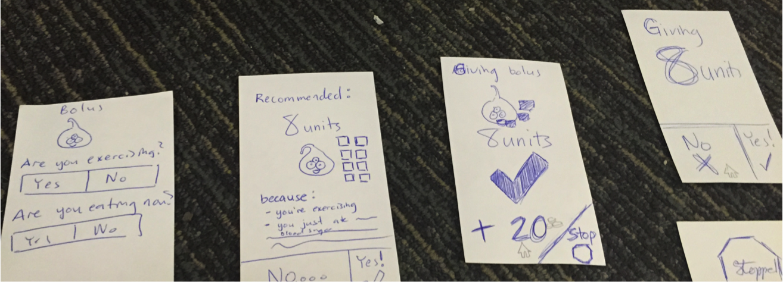
Changes
Changed “Bolus” wording to “Insulin”
More friendly, more usable
Notes:
Another comment we had was that “bolus” was not necessarily understandable to the children using this app. To make it more clear what it was about, we changed the terminology to “insulin” and “giving insulin” instead.

Slide 7
Live Demo
Tasks:
Checking Blood Sugar
Counting Carbs
Administering Insulin (Bolus)
Link to invision:
http://invis.io/XT1M31R4Z http://www.henryhtran.com/#/funpod/
Notes:
Tasks:
Checking Blood Sugar
Counting Carbs
Administering Insulin (Bolus)
Link to invision:
http://invis.io/XT1M31R4Z http://www.henryhtran.com/#/funpod/

Slide 8
Tools Used
Balsamiq to create app screens
Limited in UI elements
Cleaner look
Match dimensions of iPhone
Invision to simulate app
Links allow real-time testing (no Wizard of Oz notecard switching)
Not all features could be simulated (camera, testing strips, etc)
Notes:
Balsamiq to create app screens
Limited in UI elements
Cleaner look
Match dimensions of iPhone
Invision to simulate app
Links allow real-time testing (no Wizard of Oz notecard switching)
Not all features could be simulated (camera, testing strips, etc)

Slide 9
Summary
Tasks did not change
Wording is important - confusion over “fun” and “bolus”
Navigation to return back is important
Balsamiq helps clean design, but limited elements
Invision helpful for realistic testing, but limited simulation
Notes:
Tasks did not change
Wording is important - confusion over “fun” and “bolus”
Navigation to return back is important
Balsamiq helps clean design, but limited elements
Invision helpful for realistic testing, but limited simulation

